Slide 1
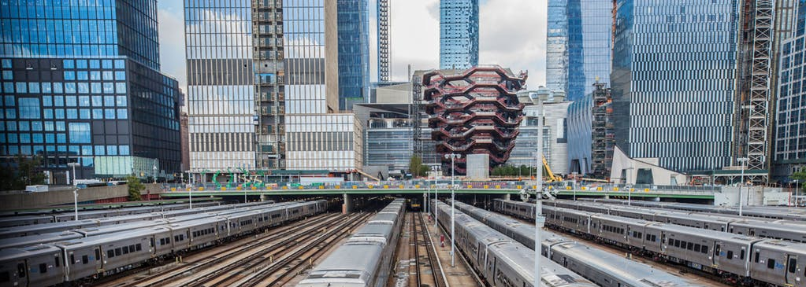
Building above railway lines
An affordable solution to new urban spaces

Slide 2
The issue of urban space
“Due to large scale urbanization, affordable housing is scarce. Few key workers such as teachers, police officers and nurses are able to find an affordable place to stay.”
Land prices in the city are high and urban land is scarce.
Building above railway lines is an affordable solution to shortage of urban space

Slide 3

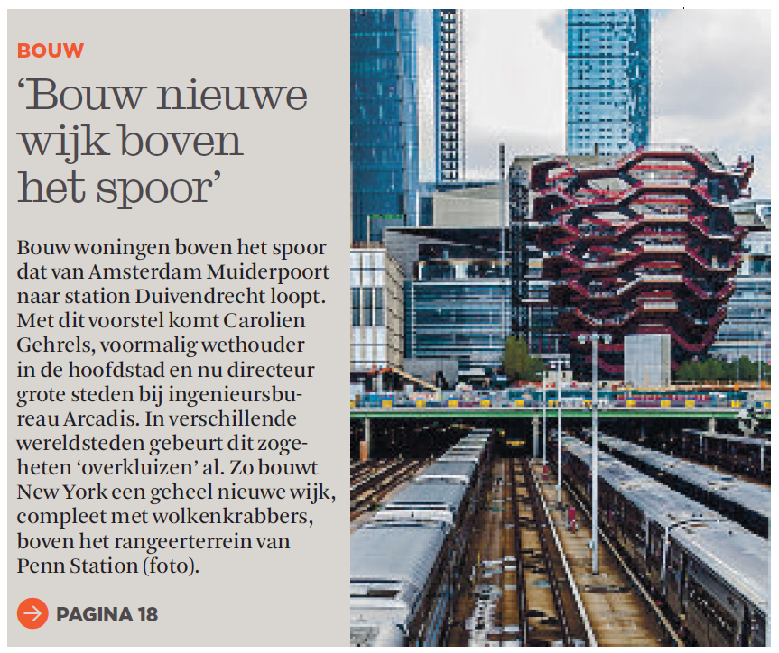
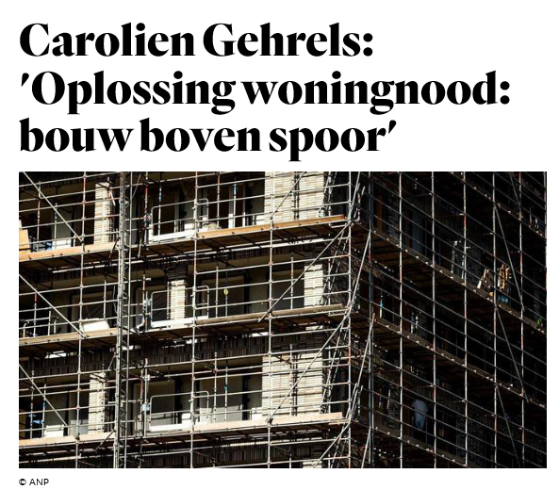
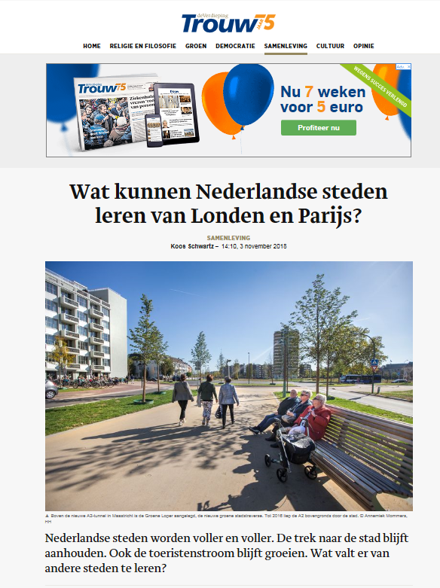

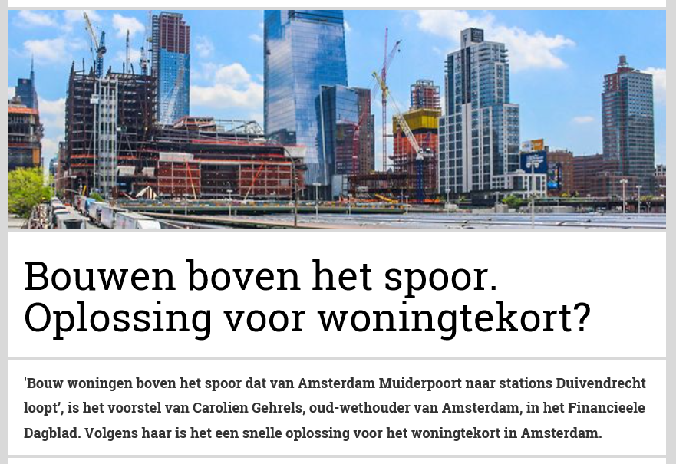
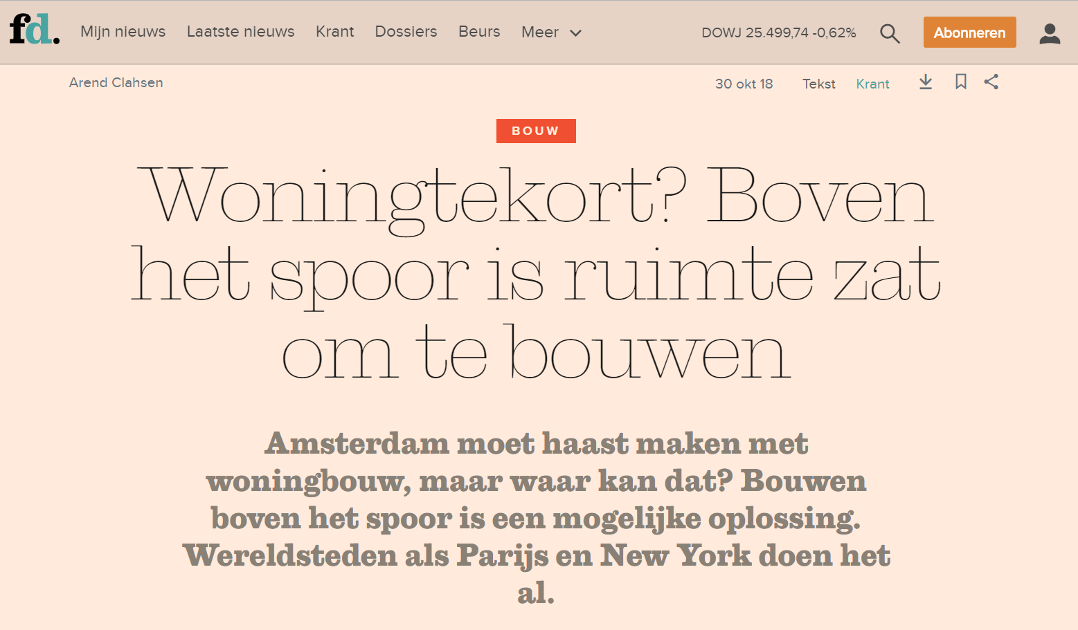
Build new
housing above
railway lines
Carolien Gehrels:
‘Solution to housing shortage:
build above the tracks’
What can Dutch cities learn
from London and Paris?
Housing shortage? Above
railway lines is plenty of
space to build
Building above railway lines.
Solution to housing shortage?

Slide 4


New urban space
€
Mixed use and compact spaces to compensate unprofitable infrastructure

Slide 5
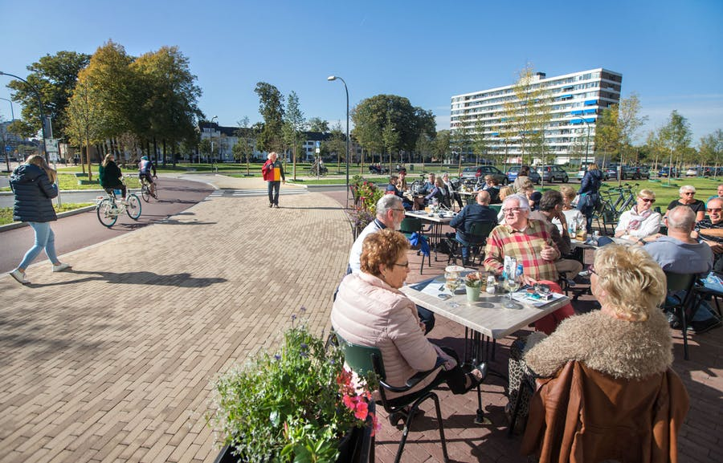
The perks of using railway space
Create high quality public space
Use real estate profits to compensate for partially unprofitable infrastructure
Opportunities for energy producing buildings and carbon capture and storage using bio based materials
Faster and cheaper to build above railway lines
Encourage use of public transport
Improve the quality of life in the city

Slide 6
Building above railway lines is not new….

Slide 7
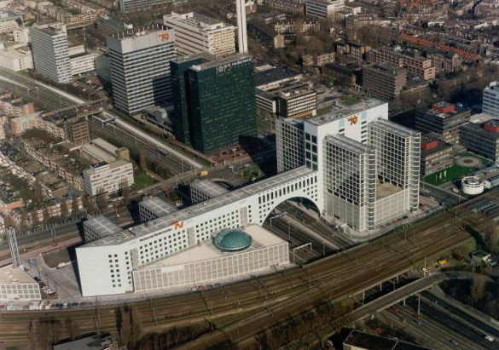
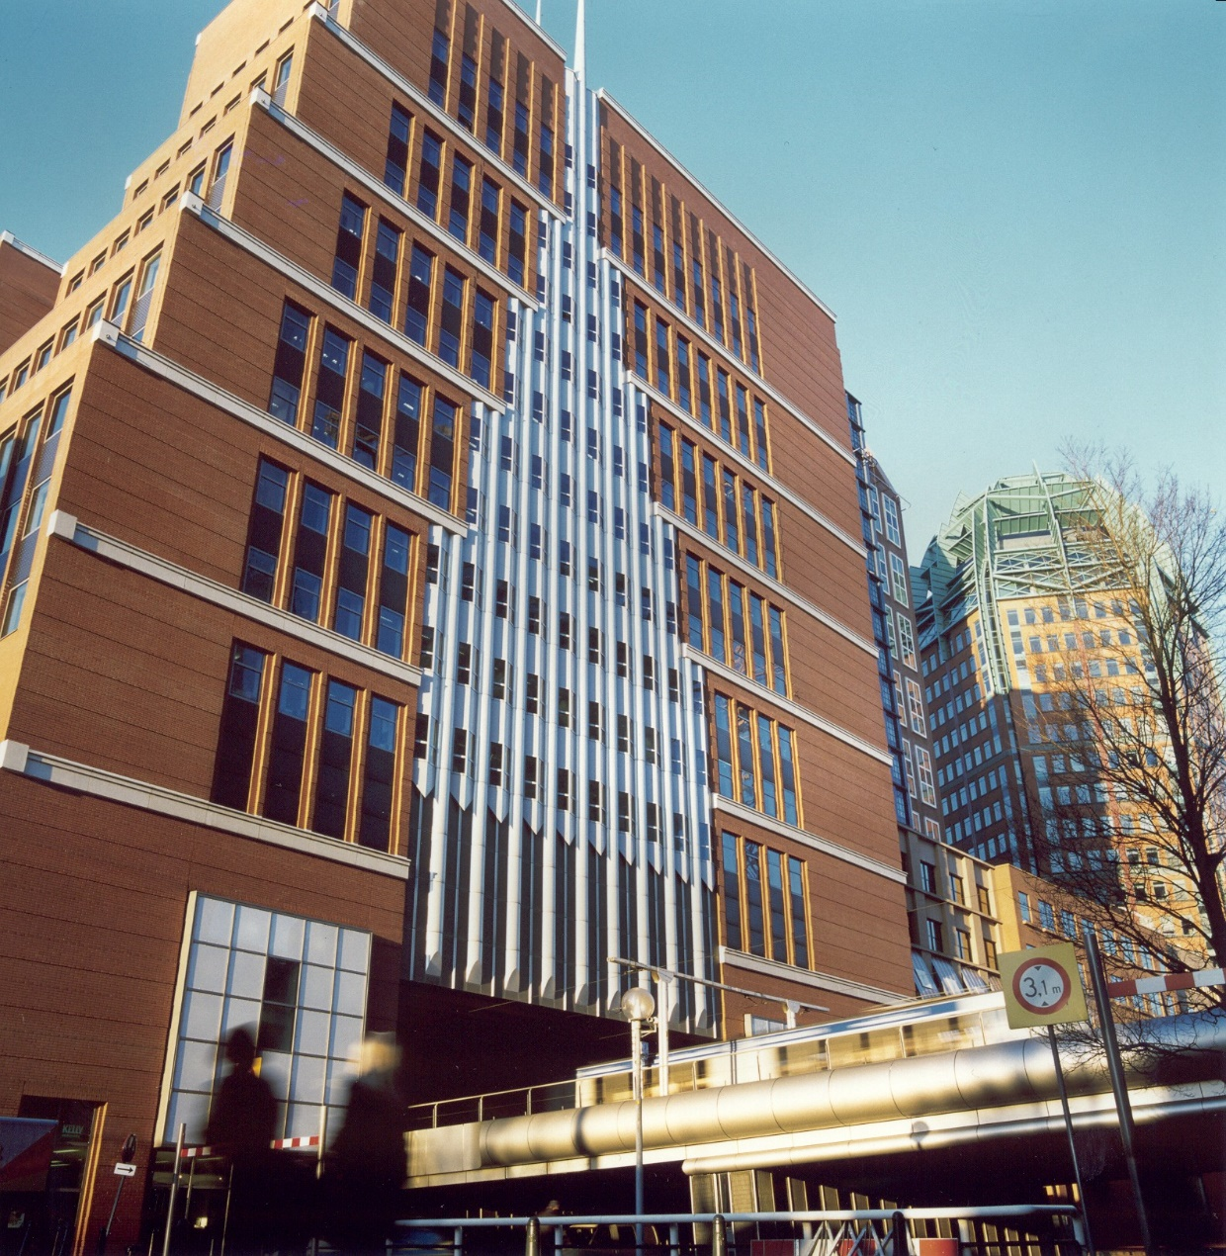
DE HAAGSE POORT
DE RESIDENTIE

Slide 8
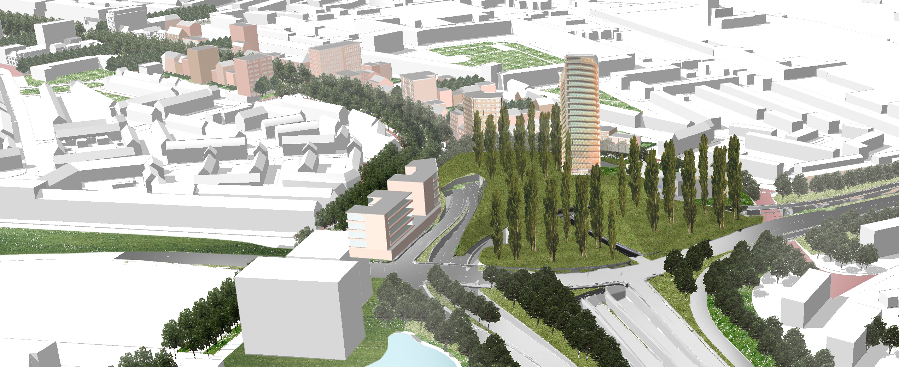
DE GROENE LOPER
MAASTRICHT

Slide 9
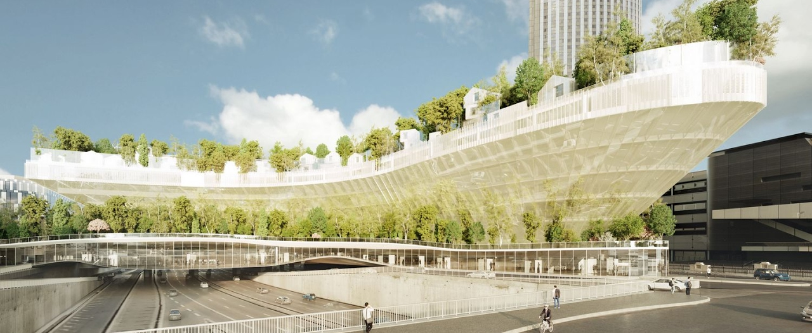
MILLES ARBRES
PARIJS

Slide 10
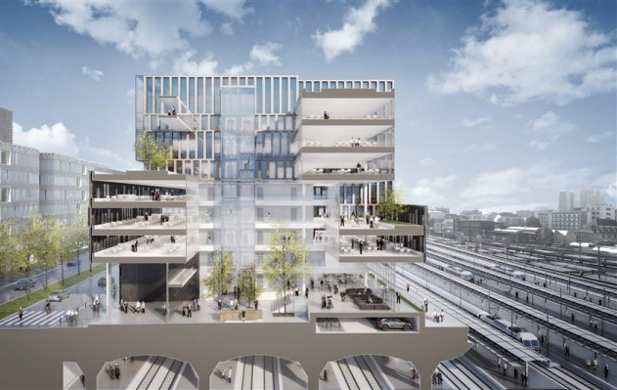
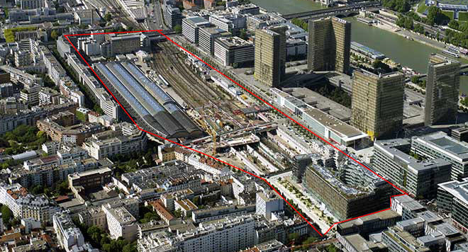
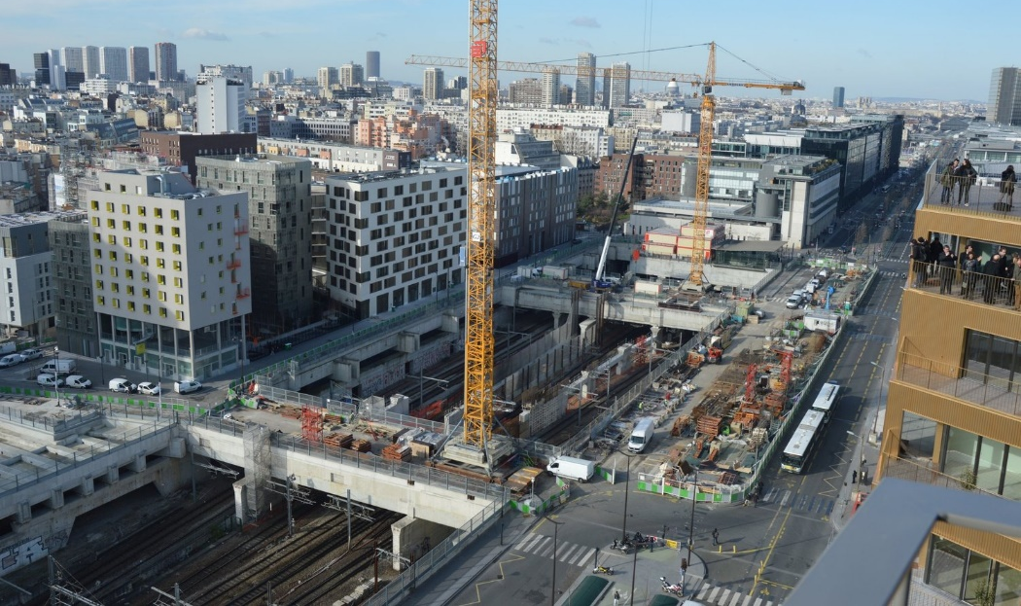
RIVE GAUCHE MASTERPLAN, GARE DE L’AUSTERLITZ
PARIJS

Slide 11
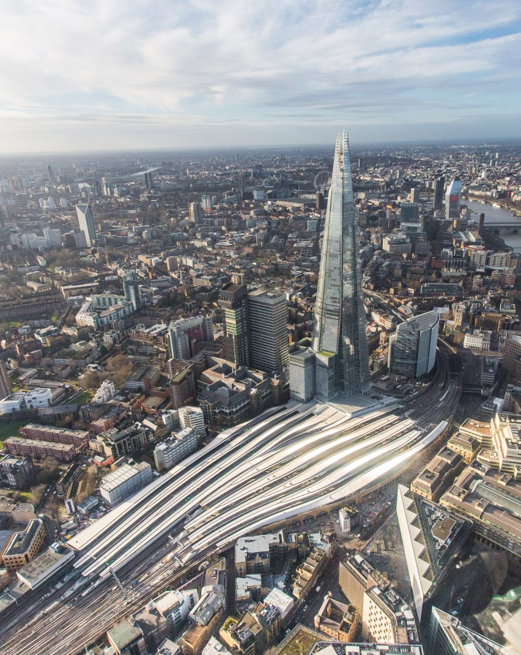
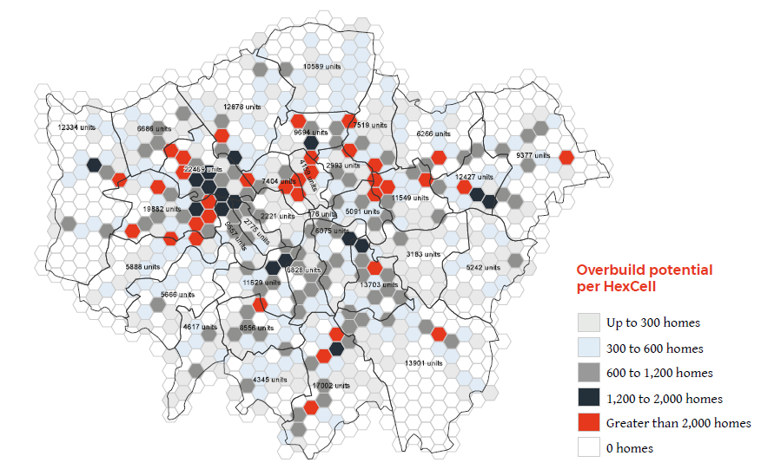
WSP, Out of Thin Air
LONDON

Slide 12
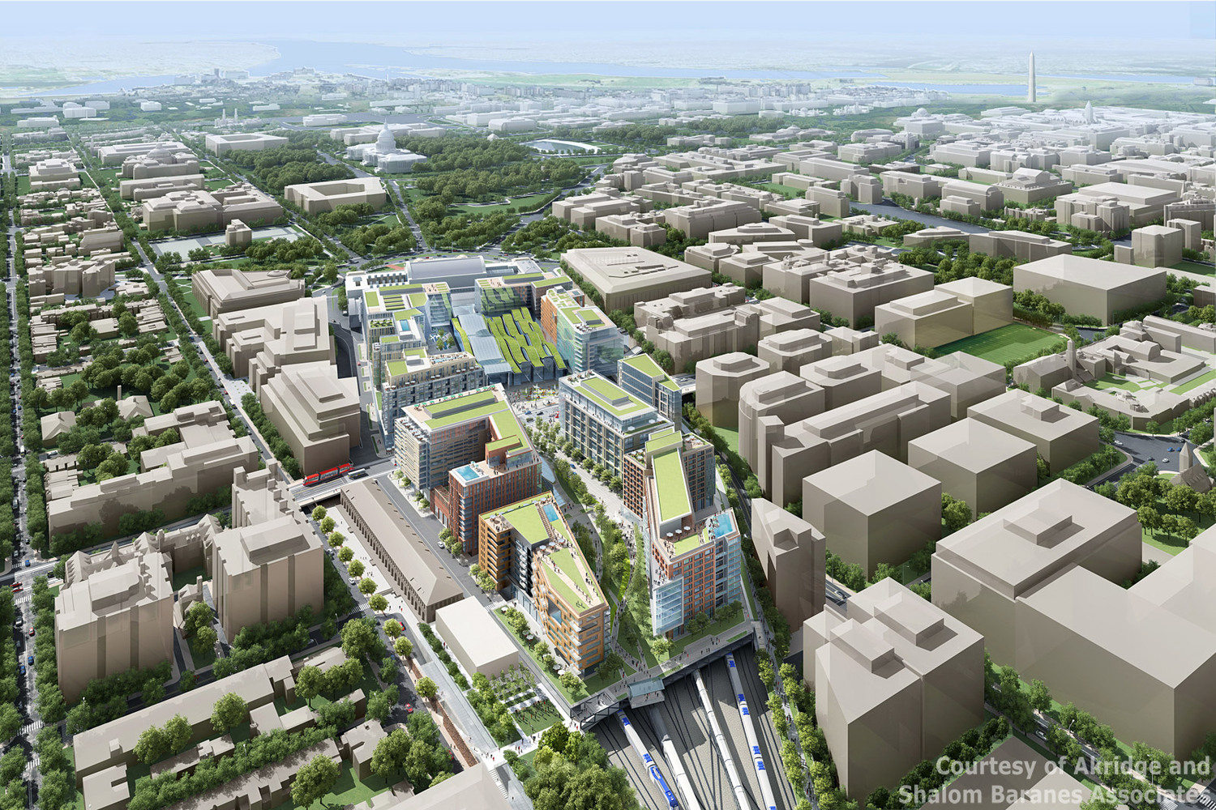
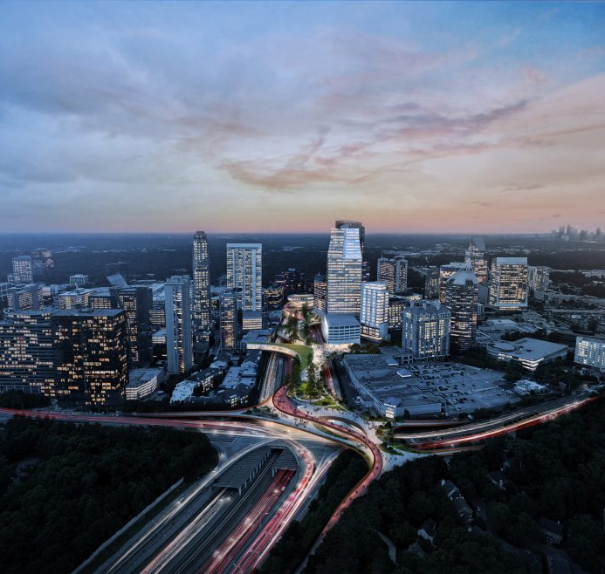
UNION STATION
WASHINGTON
UNION STATION
WASHINGTON

Slide 13
HUDSON YARD – PENN STATION
NEW YORK

Slide 14

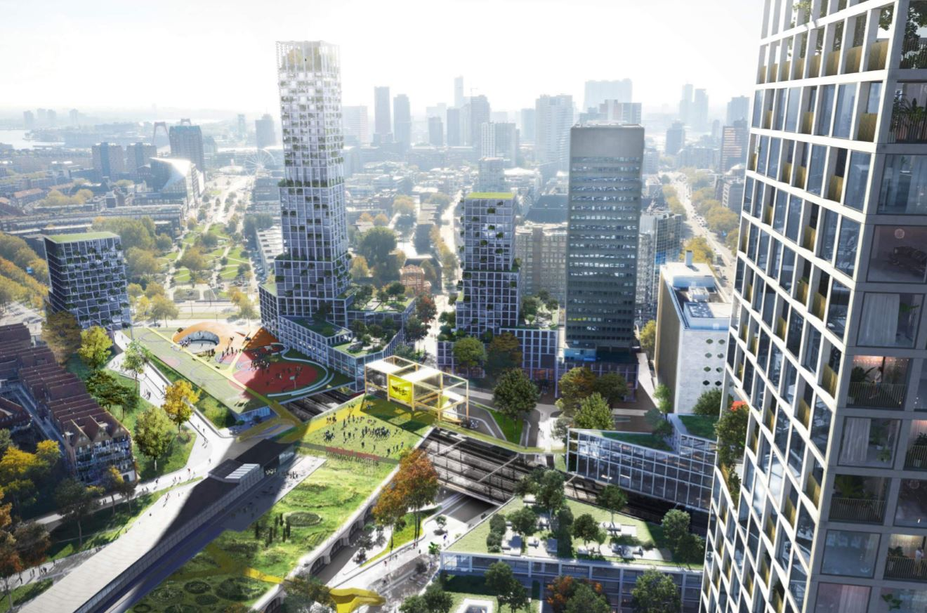
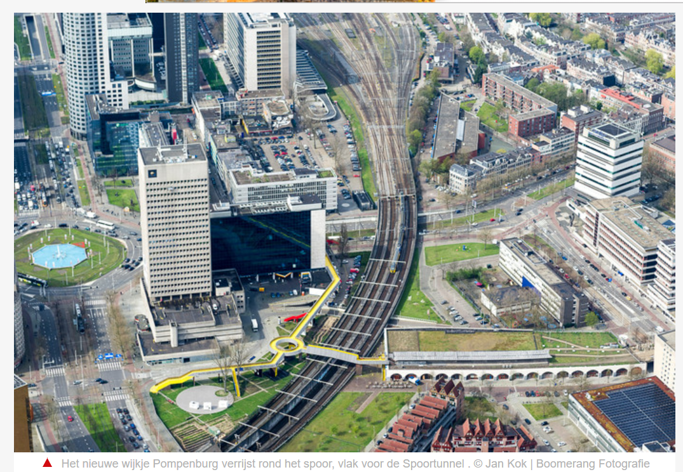
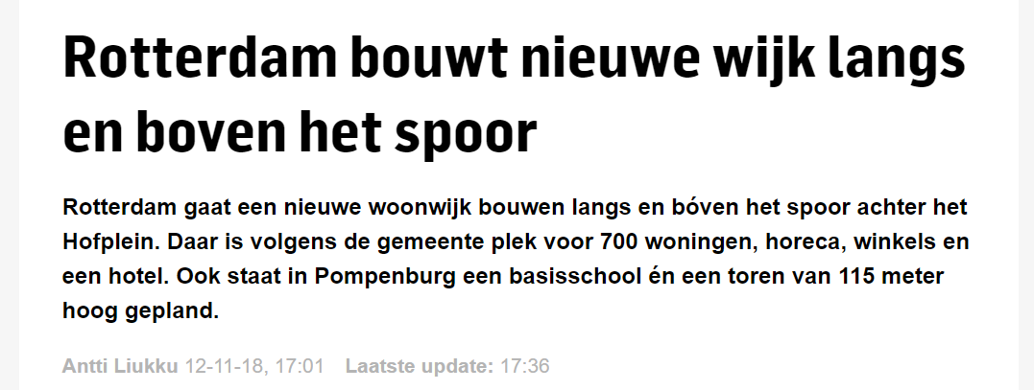
NIEUW POMPENBURG
ROTTERDAM

Slide 15

A layered approach to sustainable urbanization
“Innovation needs a time and place.”
Societal values
Conceptual values and systems
Programme
Project

Slide 16
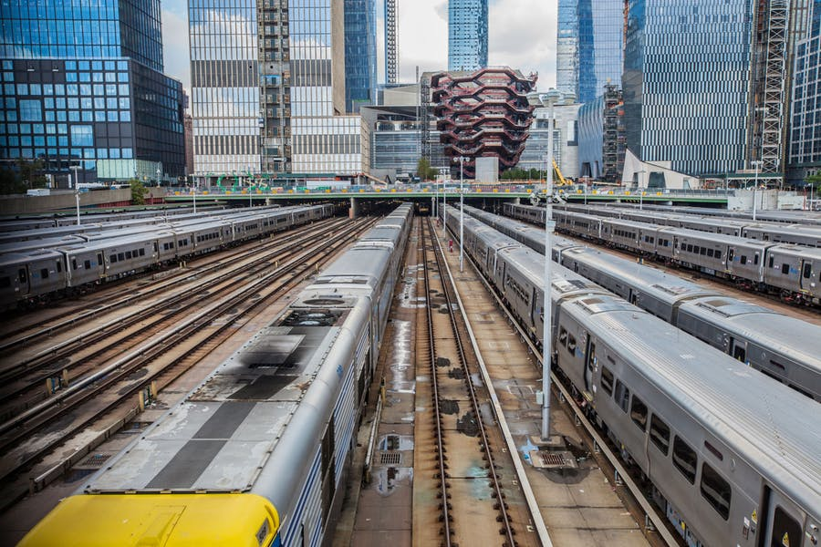
Challenges
Construction
Safety
Vibrations
Noise pollution

Slide 17
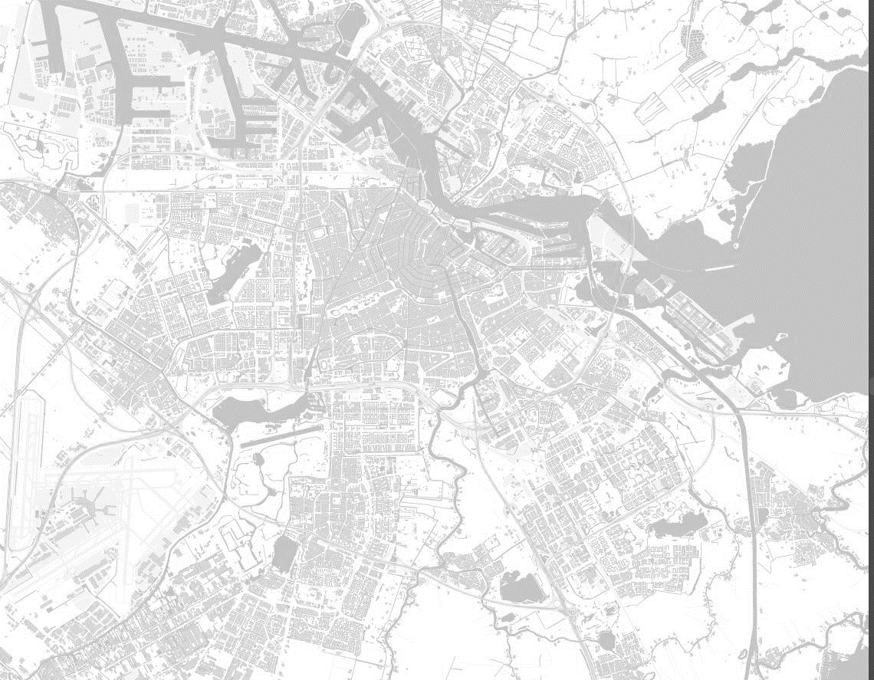
Opportunities in Amsterdam

Slide 18
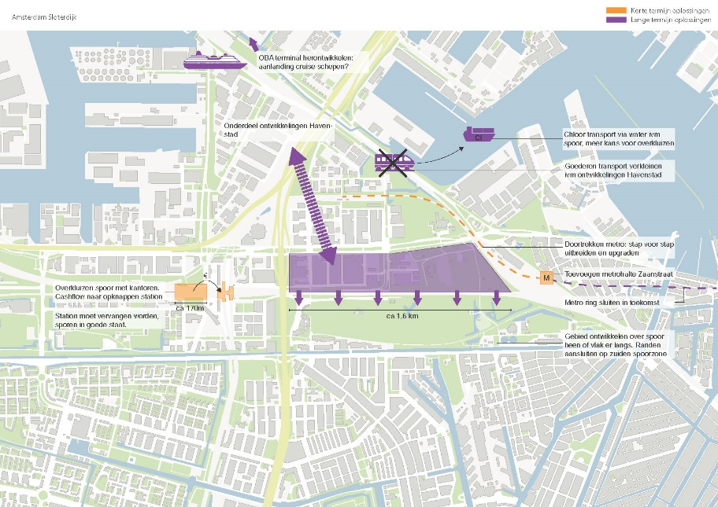
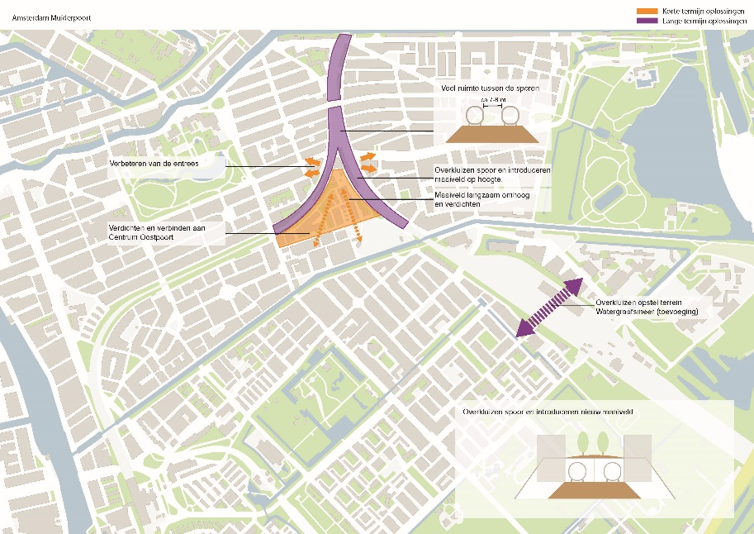
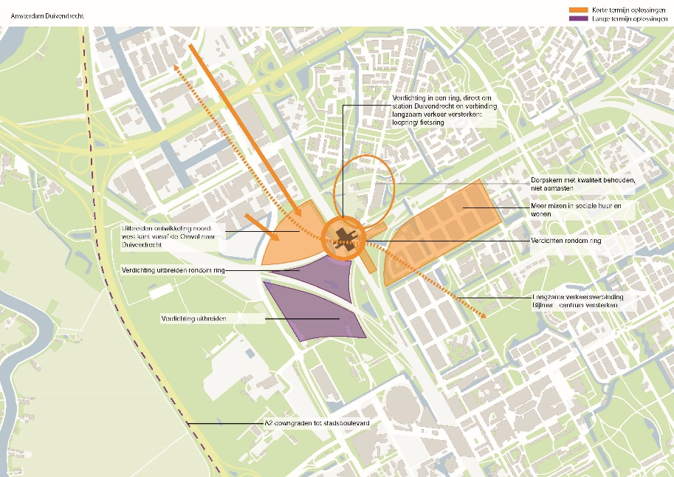
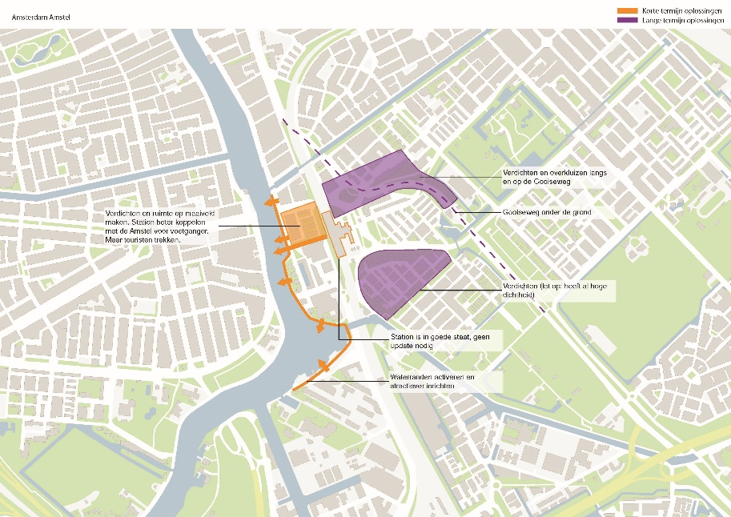
Opportunities in Amsterdam

Slide 19
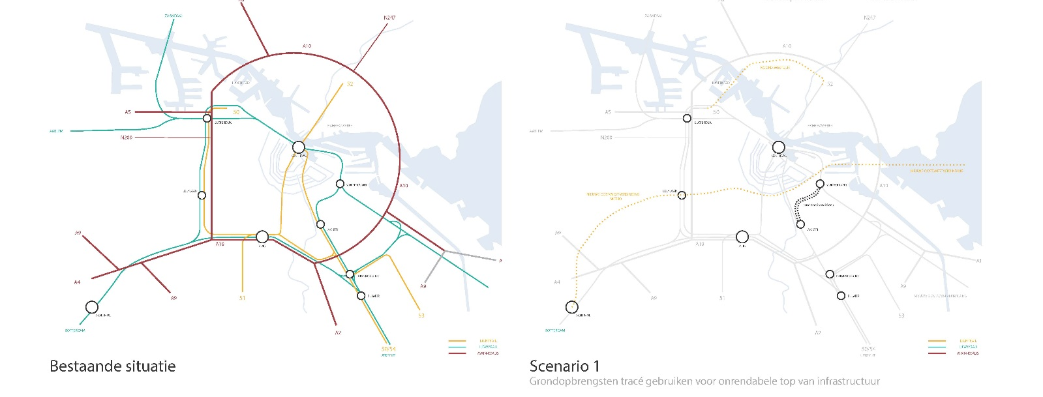
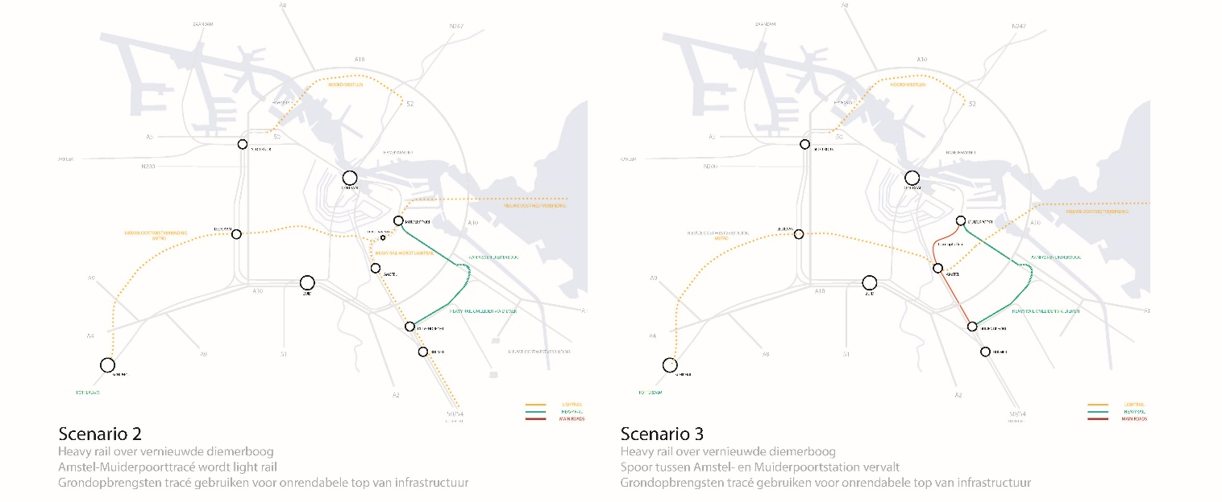
Mobility in Amsterdam

Slide 20
Why now?
10 years ago
Now
Economic crisis hit
Building over railways was unaffordable
Lack of urban space
Rising land prices
Need for affordable housing

Slide 21
New ways of collaboration and governance
Public private collaboration
We create the demand
Together with the ecosystem
New business models and financial flows
Citizen participation

Slide 22
New urban space
How can you contribute?
Building above railway lines is an affordable solution to shortage of urban space

